Slide 1

HEALTH CARE PORTAL
TEAM MEMBERS
1.Kavya Sri Myakala-U01948981
2.Sai Swaroop Manne -U01952611
3.Venkat Sai Pallapu -U01880442
4.Mahalakshmi Nagineni -U01925722

Slide 2
abstract
Emergence of health care portals plays a pivot role in improving patient access to medical services and enhancing care management
This health care portal is an integrated web-based platform that connects patients, doctors and pharmacies to streamline healthcare delivery. It offers secure access to personal medical history and appointment scheduling.
This project is developed to improve patient outcomes, streamline healthcare delivery and increase overall efficiency of health care services.

Slide 3
GOALS AND OBJECTIVE
The primary goal of a healthcare portal is to empower the patients with greater control over their health information and access to care.
In this portal the patients can share their medical records, they can schedule doctor appointments from the convenience of their homes.
Health care portals are a vital component of modern healthcare systems as it provides user-friendly and secure platform to access and manage healthcare information to the patients, doctors and an admin.

Slide 4
OPERATIONS
Insertion: We are inserting user’s medical history data, the available pharmacies and the doctors data by admin to book the slot.
Deletion: Admin can delete the doctors data if doctor is not available and the pharmacies data if the medicines are not avilable to the user/patient.
Retrieval: We are retrieving the different kind of data like doctor and pharmacies slots for the user and the medical history to the doctor.

Slide 5
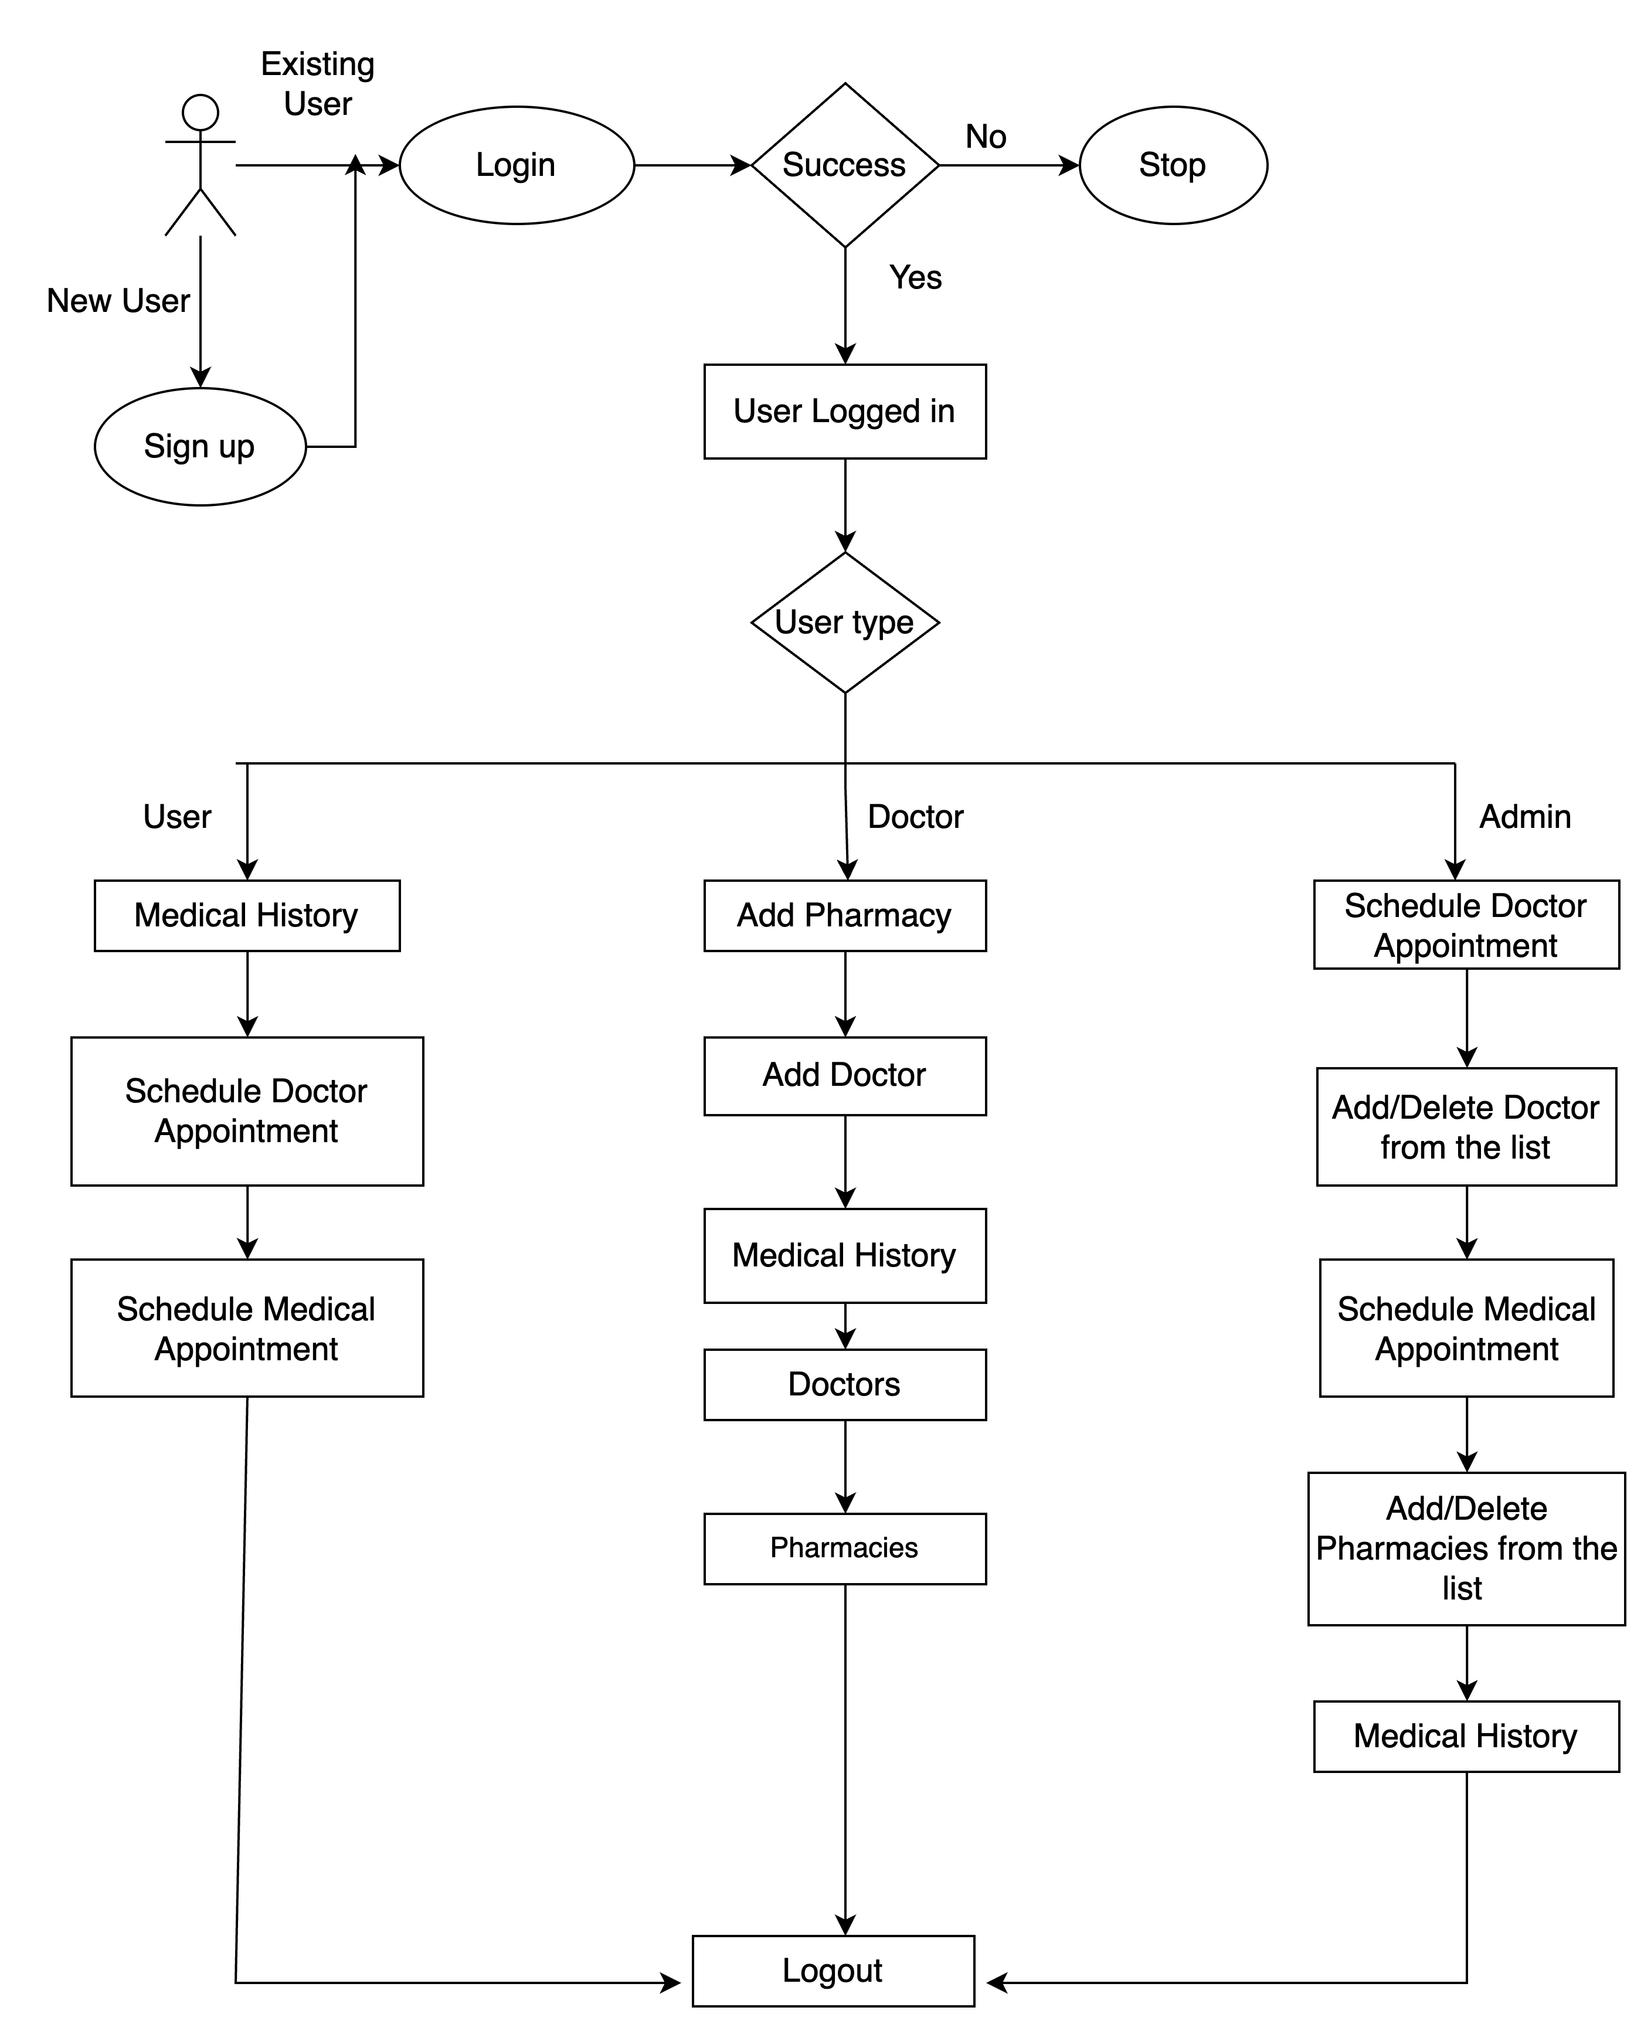
FLOW CHART
.

Slide 6
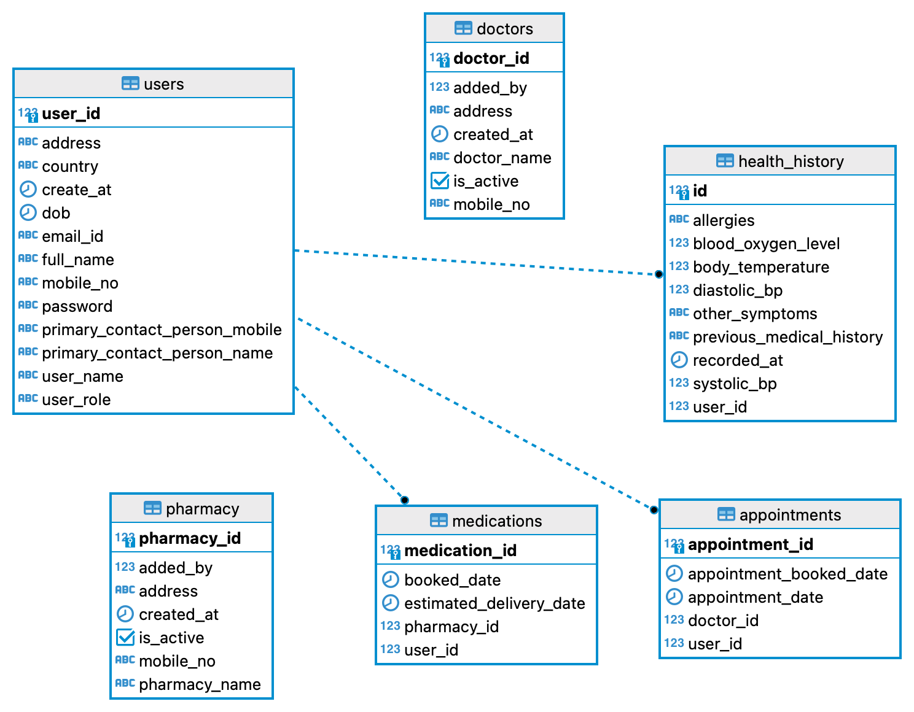
Database schema
.

Slide 7
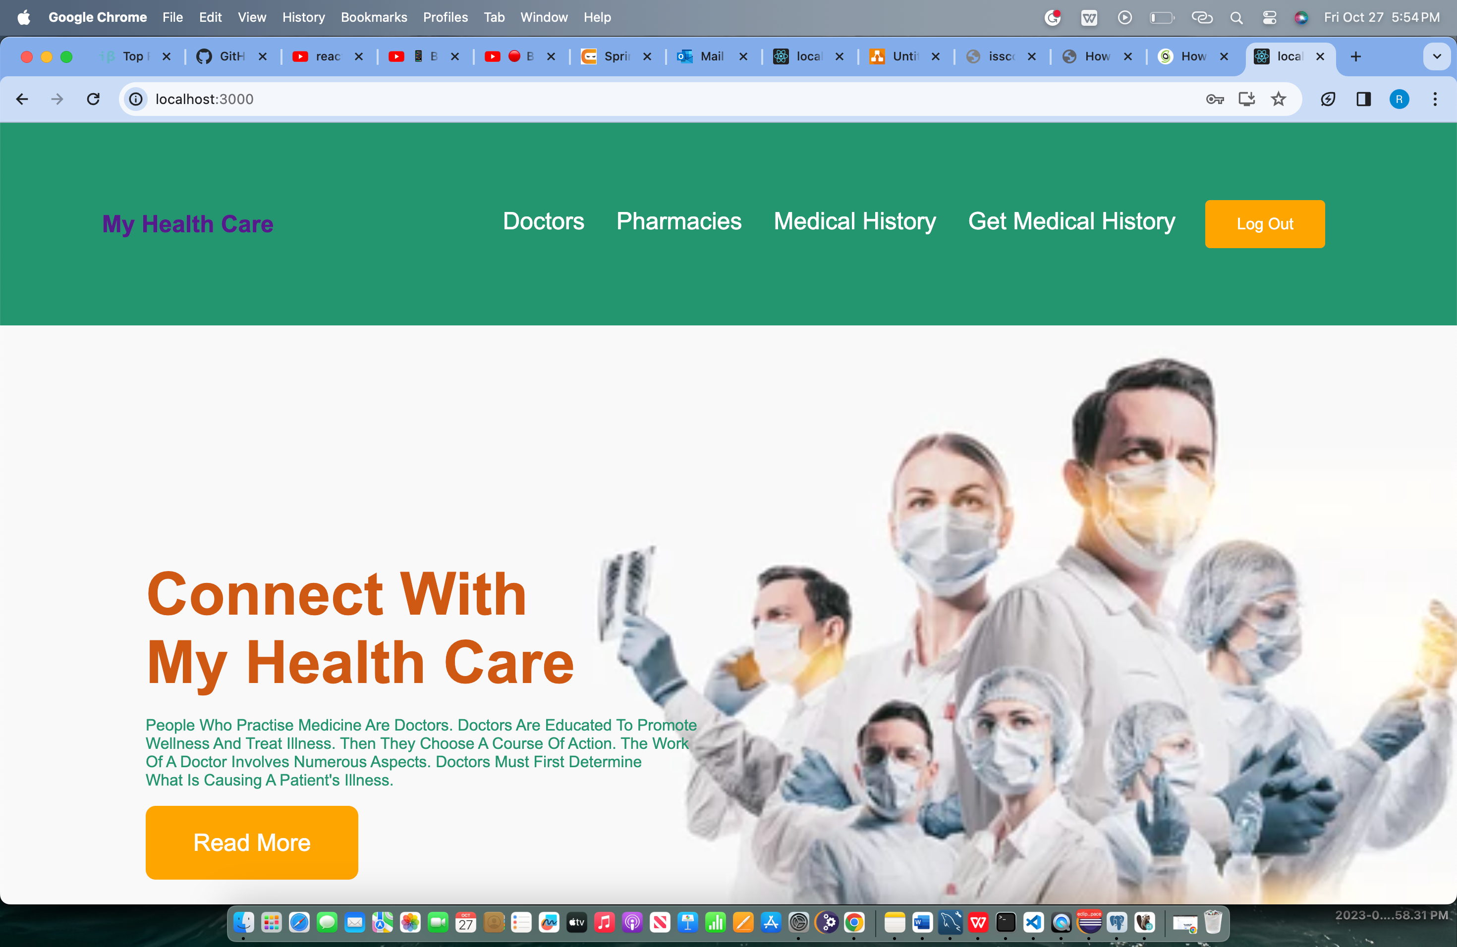
Doctor

Slide 8
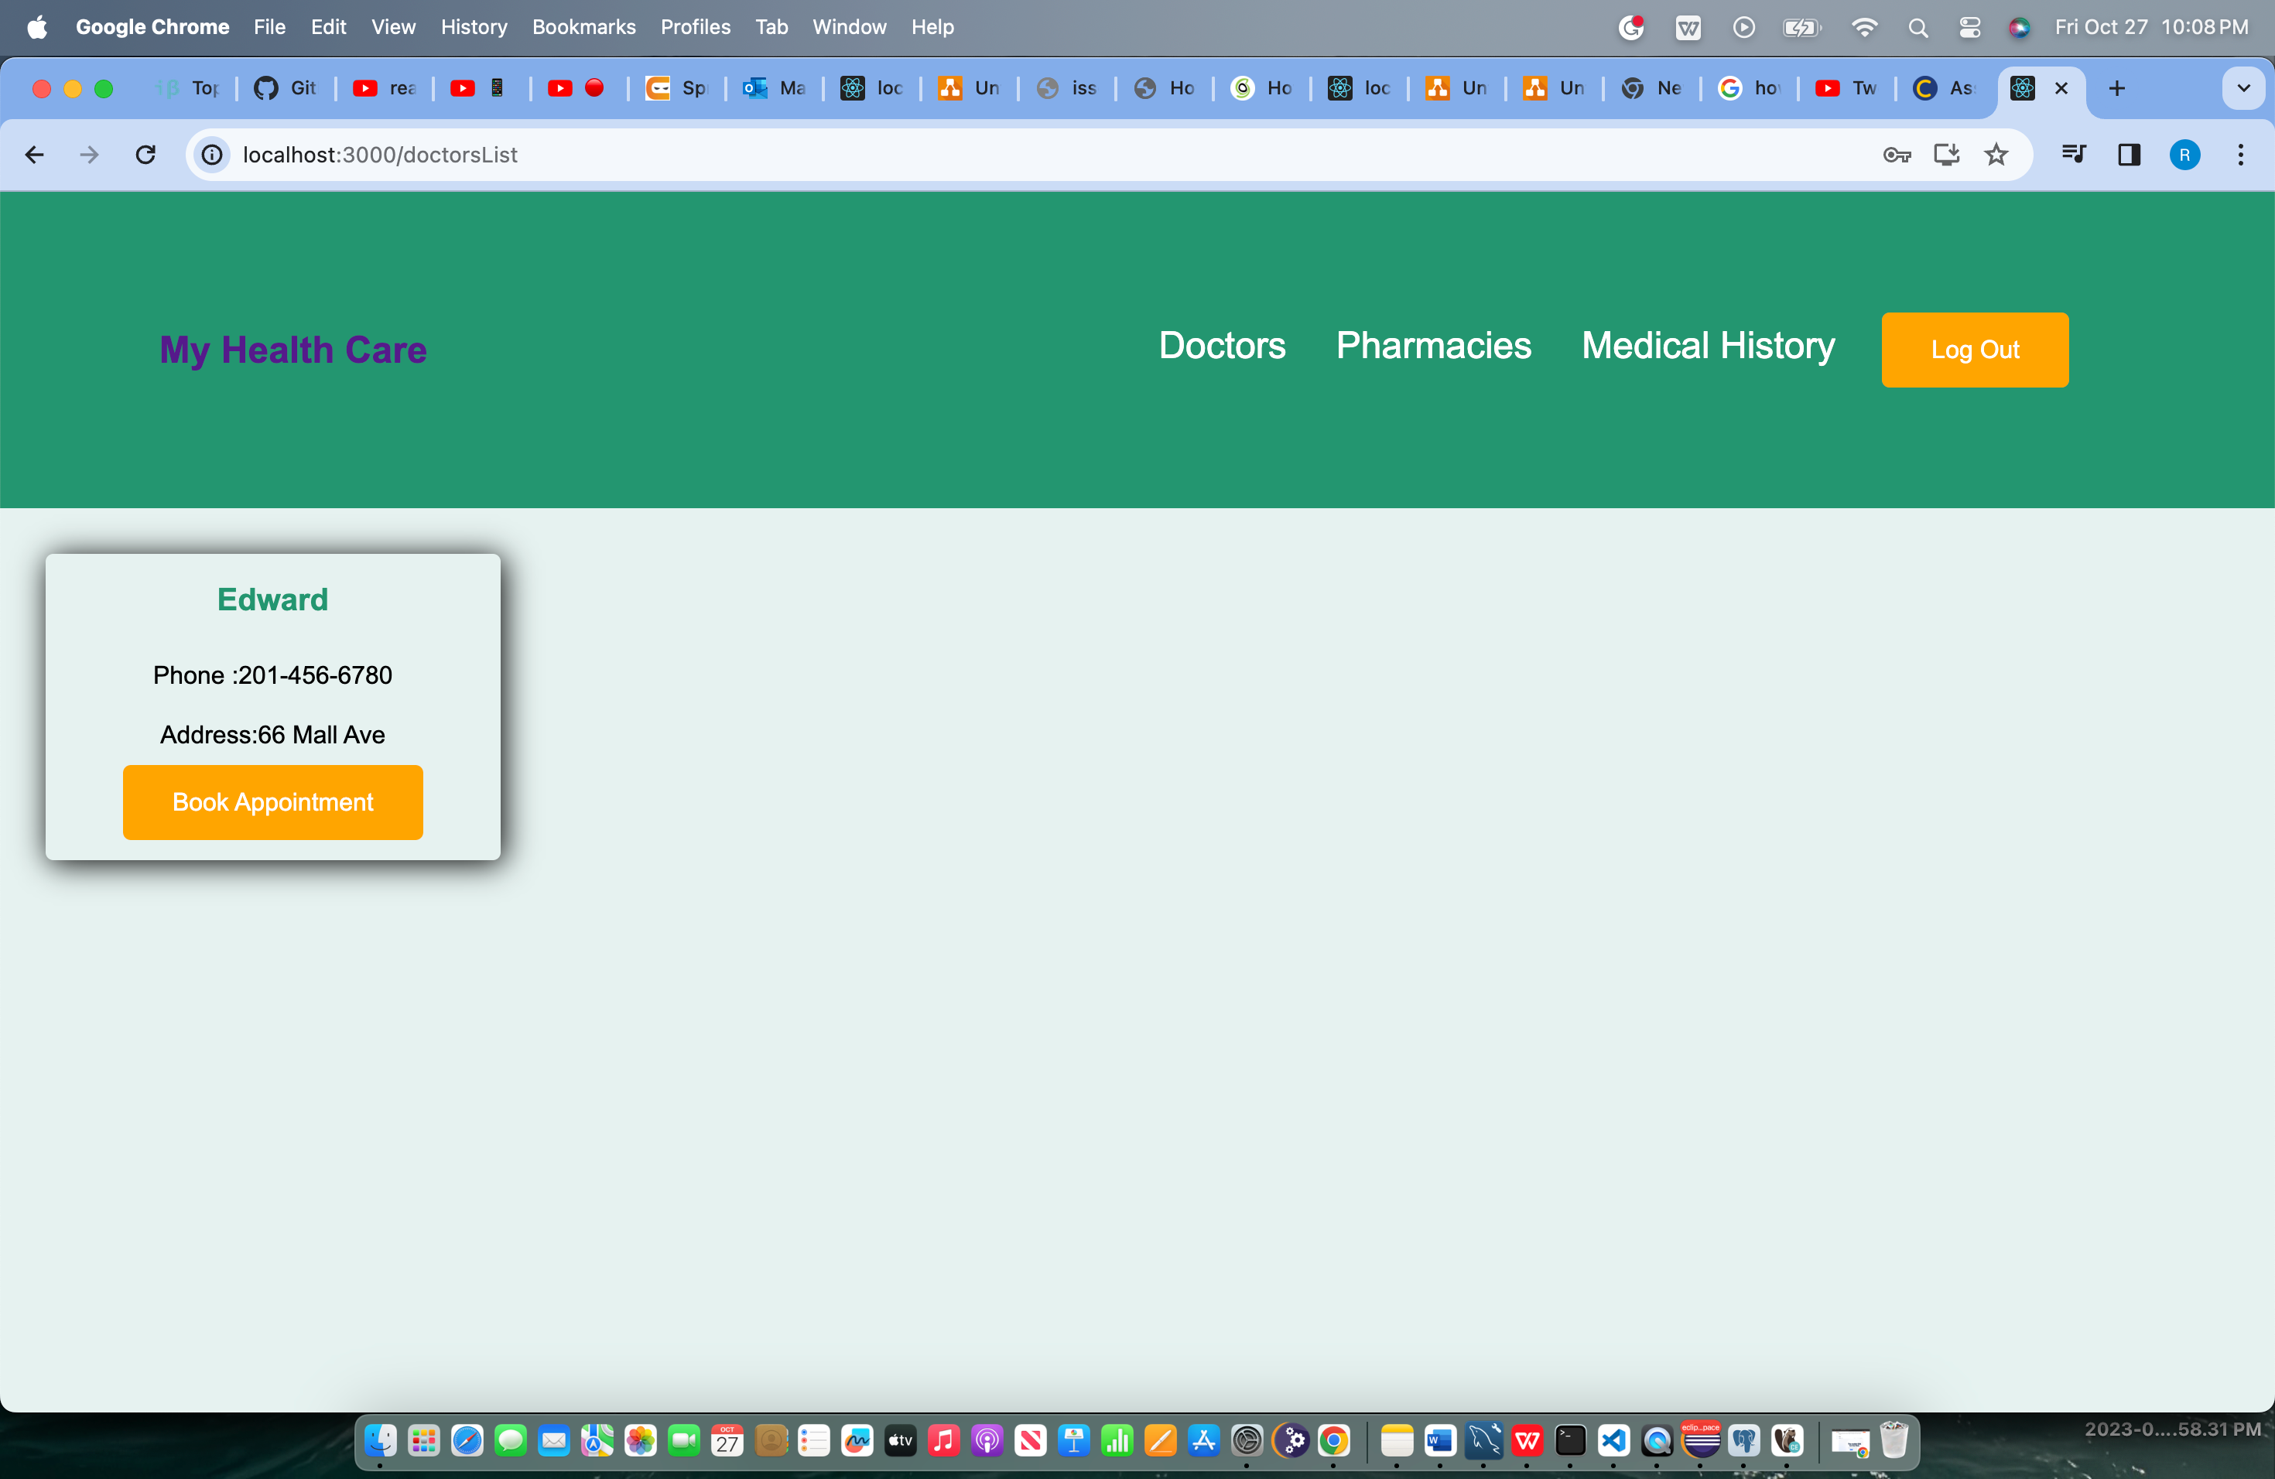
User

Slide 9
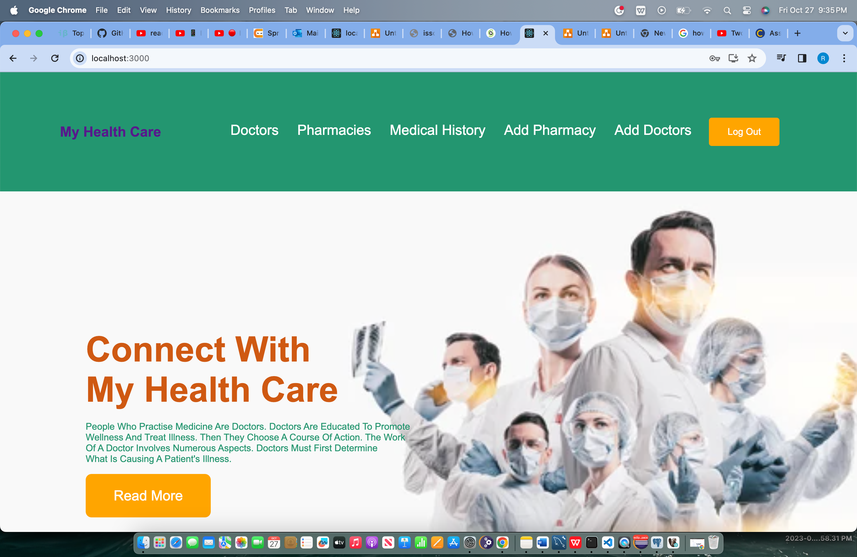
ADMIN

Slide 10
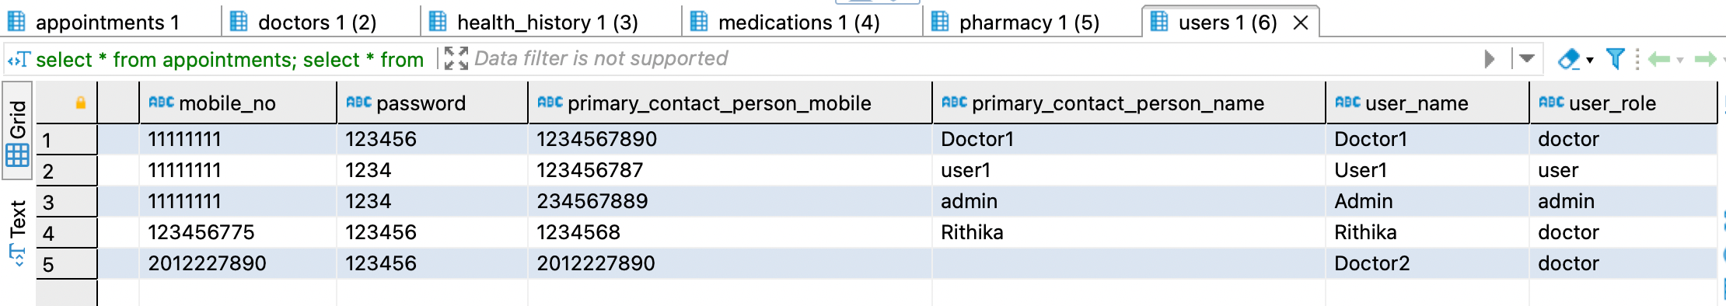
Sign up

Slide 11
ADVANTAGES & DISADVANTAGES
Advantages:
1. Easier accessibility of patient’s records
2. Faster access to the patient.
3. Appointment scheduling
4. Tools to manage conditions
5. Better experience for patients
Disadvantages:
1. Security breaches
2. Harder to use for people with disabilities
3. Technical glitches might shut down the system

Slide 12

THANK YOU

